Slide 1
Operation Remote Resupply PART 2
Renderers, Effects, and Dependency Services

Slide 2



Renderers, Effects, and Dependency Services
Renderers Used to style controls at “global” or “class” level
Effects Used to style controls or apply behavior on a case-by case basis
Dependency Services Used to “inject” platform-specific services into shared code via an “interface”
Shared Logic (C#)
iOS platform services
Android platform services
Windows platform services
Notes:
The Xamarin Forms platform support a robust set of features and services to leverage platform-specific services using concepts such as custom renderers, effects, and dependency services. In Xamarin Forms, user interfaces are rendered using the native controls of the target platform, enabling apps to retain the appropriate look and feel for each platform. Other features, such as custom renderers, enable developers to override this process to customize the appearance and behavior of controls on a per-platform basis. By implementing concepts such as dependency injection, dependency services can “find” the right platform implementation native functionality to be easily accessed via shared code.

Slide 3
Renderers
Custom Renderer
Shared UI (XAML)
Custom Renderer
Custom Renderer
Notes:
In Xamarin Forms, custom renderers provide a global approach for customizing the appearance and behavior of controls, from small styling changes to sophisticated platform-specific layout customization. Renderers for can be added to a single platform project to customize the control for that platform only, or to all platforms to create specific renderers for each project. In this example, an out-of-the-box ProgressBar control has a different appearance on each platform, however the use of a custom renderer can provide a consistent look to the ProgressBar on every platform.
NOTE: The terms “renderer” and “custom renderer” can be used interchangeably in this context, as all “renderers” created by a developer are essentially “custom” and the use of the term is unnecessarily redundant.

Slide 4
Implementing a Renderer
Create a class in each supported platform-specific project
Write platform-specific code in each project
Target a specific parent class type
Programmatically export the renderer
[assembly: ExportRenderer(typeof(Xamarin.Forms.ProgressBar), typeof(FuelRenderer))]
namespace DroneLander.Droid.Renderers
{
public class FuelRenderer : ProgressBarRenderer
{
.
.
.
}
}
Notes:
A custom Renderer is applied to all controls of a specific control type, making it simple to apply application-wide control over control behavior and styling outside of common control methods, properties, and behaviors, and has a similar pattern to dependency injection.
This example, which comes from Lab #2, creates and exports a renderer targeting a ProgressBar control on Android to display Fuel levels. For clarity, it omits the actual platform-specific implementation of styling.

Slide 5
Effects
An effect is recommended when changing the properties of a platform-specific control will achieve the desired result.
A custom renderer is required when there's a need to override methods of a platform-specific control.
A custom renderer is required when there's a need to replace the platform-specific control that implements a Xamarin Forms control.
App
Effect (iOS)
Effect (Android)
Effect (Windows)
Platform Effect
Platform Effect
Platform Effect
Xamarin iOS assemblies
Xamarin Android assemblies
UWP assemblies
Notes:
In Xamarin Forms user interfaces are rendered using the native controls of the target platform, allowing Xamarin Forms applications to retain the appropriate look and feel for each platform. Effects allow the native controls on each platform to be customized without having to resort to a custom renderer implementation.
Anything you can do with an effect can also be done with a custom renderer, however effects are more lightweight and (in general) targeted on a control-by-control basis.
Custom renderers and effects often provide the same ultimate functionality, however effects are preferred where possible, based on the scope of the controls affected.

Slide 6
Implementing an Effect
Create a class in each supported platform-specific project
Write platform-specific code in each project
Inherit the PlatformEffect interface
Target a specific group name
Programmatically export the effect
[assembly: ResolutionGroupName("Xamarin")]
[assembly: ExportEffect(typeof(DroneLander.Droid.DigitalFontEffect), "FontEffect")]
namespace DroneLander.Droid
{
public class DigitalFontEffect : PlatformEffect
{
.
.
.
}
Notes:
The steps to implementing an effect in Xamarin Forms are almost identical to implementing a custom renderer, however instead of inheriting from a control interface, an effect inherits from a generic PlatformEffect interface.
This example, which comes from Lab #2, creates and exports an effect to use a custom font on Android to display a more “digital” font readout on Labels. For clarity, it omits the actual platform-specific implementation of font management.

Slide 7


Using an Effect
Create a class in shared code
Inherit from the RoutingEffect class
Create a resource in markup to reference the effect
Add property to a control to reference the resource
<Label Style="{DynamicResource DisplayLabelStyle}"
Text="{Binding Altitude, Converter={StaticResource DecimalDisplayConverter}}"
local:DigitalFontEffect.FontFileName="Consolas" />
Notes:
Applying effects to controls, on a control-by-control basis is achieved simply by adding markup (XAML) property to a control to reference the resource identified for a given effect.
This example, which comes from Lab #2, applies the DigitalFontEffect to the Altitude Label. For clarity, it omits the actual platform-specific implementation of font management.

Slide 8
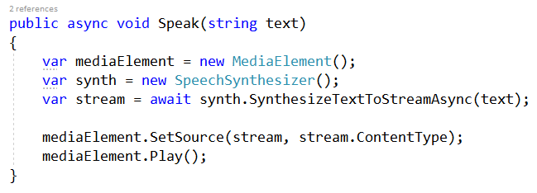
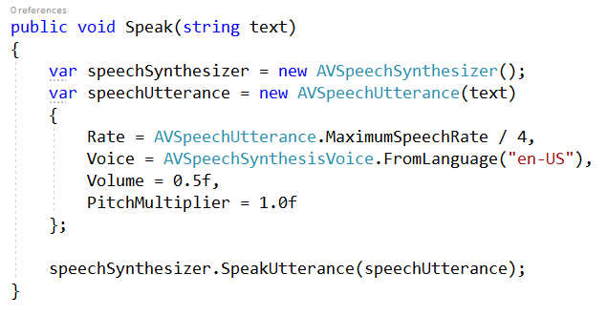
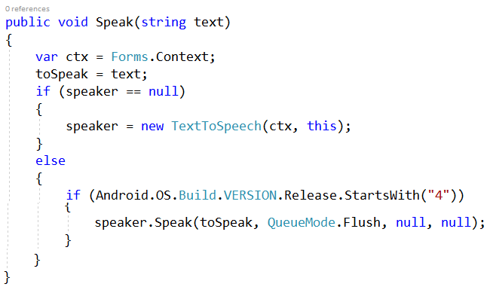
Dependency Services
Create an interface in shared code that “describes” methods
Create an implementation in platform-specific code that contains methods
Register the service to be “seen” by shared code
Notes:
Every platform has features and services that are unavailable or implemented differently on a given platform. A Dependency Service implementation can access these differences without affecting shared code.

Slide 9
Dependency Injection
Standard Service
client
service
CALL SERVICE
Injected Service
client
service
INJECTION
Notes:
Dependency injection is a pattern that implements inversion of control for resolving dependencies. A dependency is an object that can be used (typically called a dependency service). An injection is the passing of a dependency to a dependent object (a client) that would use it.

Slide 10
Implementing a Dependency Service
An interface
Platform-specific implementation
Service registration
Service call
Interface declaration
Dependency Service “Get”
Android
iOS
Windows
Notes:
In Xamarin Forms, the actual implementation of a Dependency Service is distributed across various levels:
An interface
An implementation
A registration
A service call

Slide 11

Implementing an Interface
public interface IAudioService
{
void AdjustVolume(double volume);
void ToggleEngine();
Action OnFinishedPlaying { get; set; }
}
Shared code
Android
iOS
Windows
Notes:
An interface defines how your shared code will interact with platform-specific functionality. In general, there is no difference between a standard object interface and a Dependency Service interface.
This example, which comes from Lab #2, shows the interface defined for the IAudioService found in shared code.

Slide 12
Implementing an Implementation
public class AudioService : IAudioService
{
private MediaPlayer _mediaPlayer;
public Action OnFinishedPlaying { get; set; }
public AudioService()
{
}
public void AdjustVolume(double level)
{
.
.
.
}
Shared code
Android
iOS
Windows
Notes:
An implementation is the platform-specific code that contains methods and properties that mimic or implement the actual functionality in each project for each platform that you are targeting.
This example, which comes from Lab #2, is the actual implementation of the platform-specific AudioService. For clarity, it omits the actual platform-specific implementation audio management.

Slide 13
Implementing a Registration
Shared code
[assembly: Dependency(typeof(AudioService))]
namespace DroneLander.Droid.Services
Android
iOS
Windows
Notes:
A registration is a mechanism for letting shared code know an implementation is available and accessible. An implementation of the interface needs to be registered as Dependency Service with a metadata attribute.
This example, which comes from Lab #2, is the actual registration of the platform-specific AudioService.

Slide 14



Calling a Service
Shared code
Android
implementation
interface
iOS
implementation
Windows
implementation
AudioPlayer = Xamarin.Forms.DependencyService.Get<IAudioService>();
AudioPlayer.AdjustVolume(volume);
Notes:
When a shared project has been set up with a common interface and implementations for each platform, simply call the service to get the correct implementation at runtime.
This example, which comes from Lab #2, demonstrates calling the AudioService dependency service from shared code.

Slide 15
Lab Walkthrough
Renderers, Effects, and Dependency Services

